Slide 1
AI601: DATA ENGINEERING FOR AI SYSTEMS
SmartCrop: Weather Forecasting and Yield Prediction System
Group Members: Faizan Ullah, Salman Ahmad, Ahsan khan, Zafir

Slide 2
PROJECT OVERVIEW
To design an automated system that predicts whether forecast for farmers and to predict their crop yield from their sensor’s data.
Faizan = Architecture, Airflow, Dags, Kafka , Spark, Aws
Salman = Pipeline for scripts, ML Model, ML pipeline
Ahsan = Architecture, ML pipeline, ML model, Deployment on Hugging Face spaces
Zafir = S3, Postgres setup (DB), pipeline for scripts

Slide 3
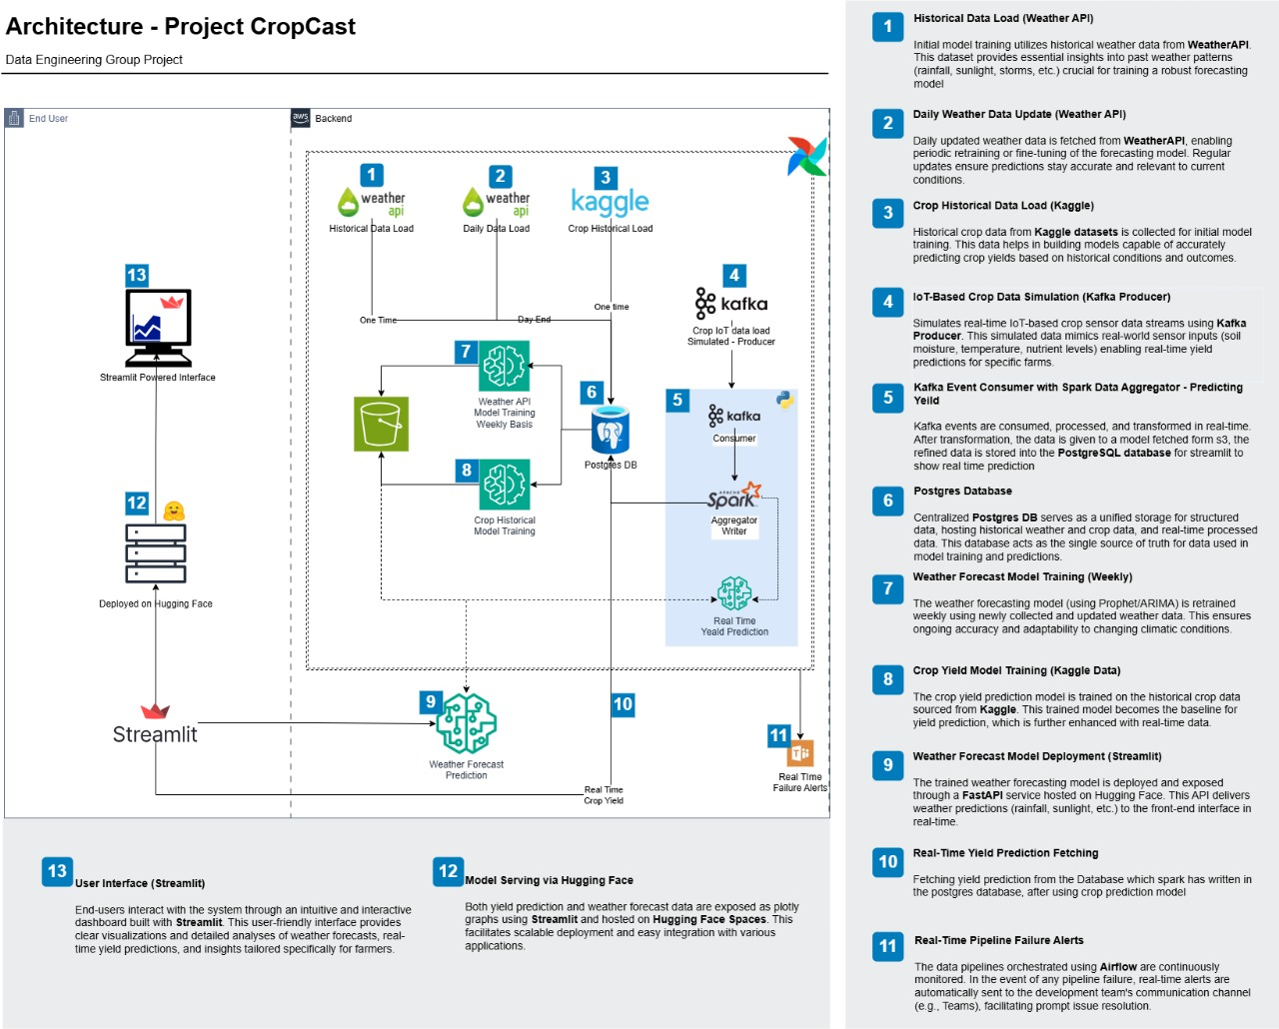

Slide 4
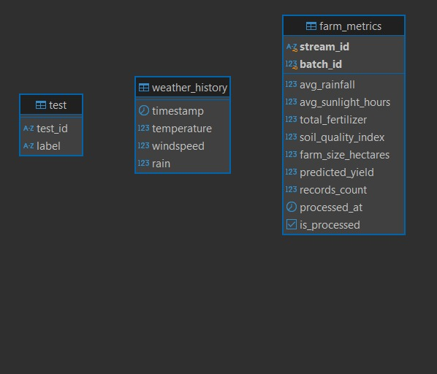
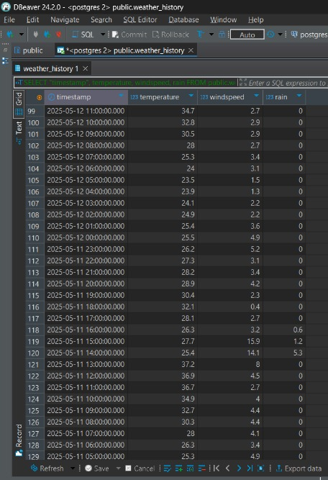
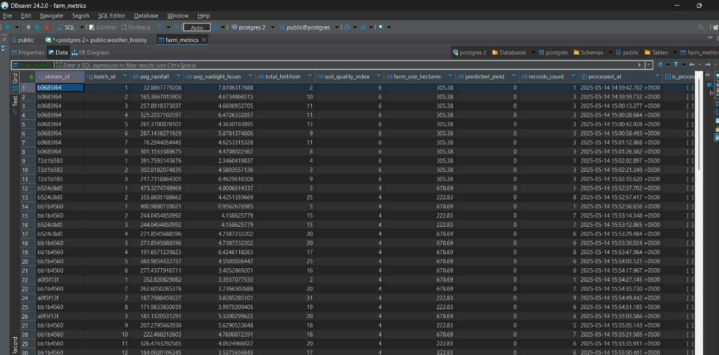
SCHEMA DIAGRAM

Slide 5
AI Usage
For coding errors/bug fixes.
Vibe Coding / Code Generation using Copilot/GPT/Claude.
End to End Installation Guides.
Architectural Decision Making
Validating documentation of libraries
Discussing ideas of project, algorithm and problem solving
For paraphrasing our report. It has been validated by us for errors

Slide 6
CHALLENGES
Dependency conflict issues of libraries – multiple virtual environment
Cross platform library versioning issue
Airflow scheduler in cloud and local have issues when works with other services like kafka and Spark with limited resources
HuggingFace Space’s streamlit direct integration is no more supported as we did in class – learning curve
Integration of multiple services in one environment.
Integrating component in teams – coordinating remotely

Slide 7
LEARNINGS:
Architectural discussion and exploring multiple options
Developing scripts for pipeline and debugging
Presenting scripts to team members and justifying the deliverables.
HuggingFace Space deployment
Using Cloud service as S3, Postgres
Simulating sensors using Kafka and Using Spark libraries for Postgres
Orchestration using Airflow.

Slide 8
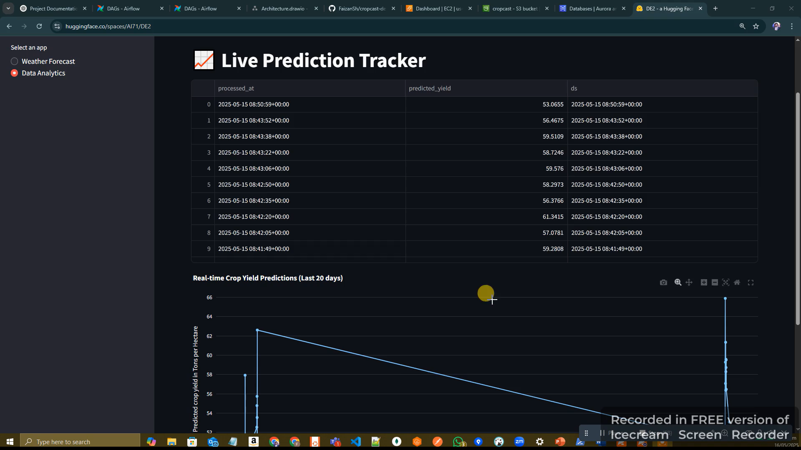
DEMO
https://drive.google.com/file/d/1lr3QKxMR0d79HkKe9yM87fpiXZk5vreJ/view?usp=drive_link

Slide 9
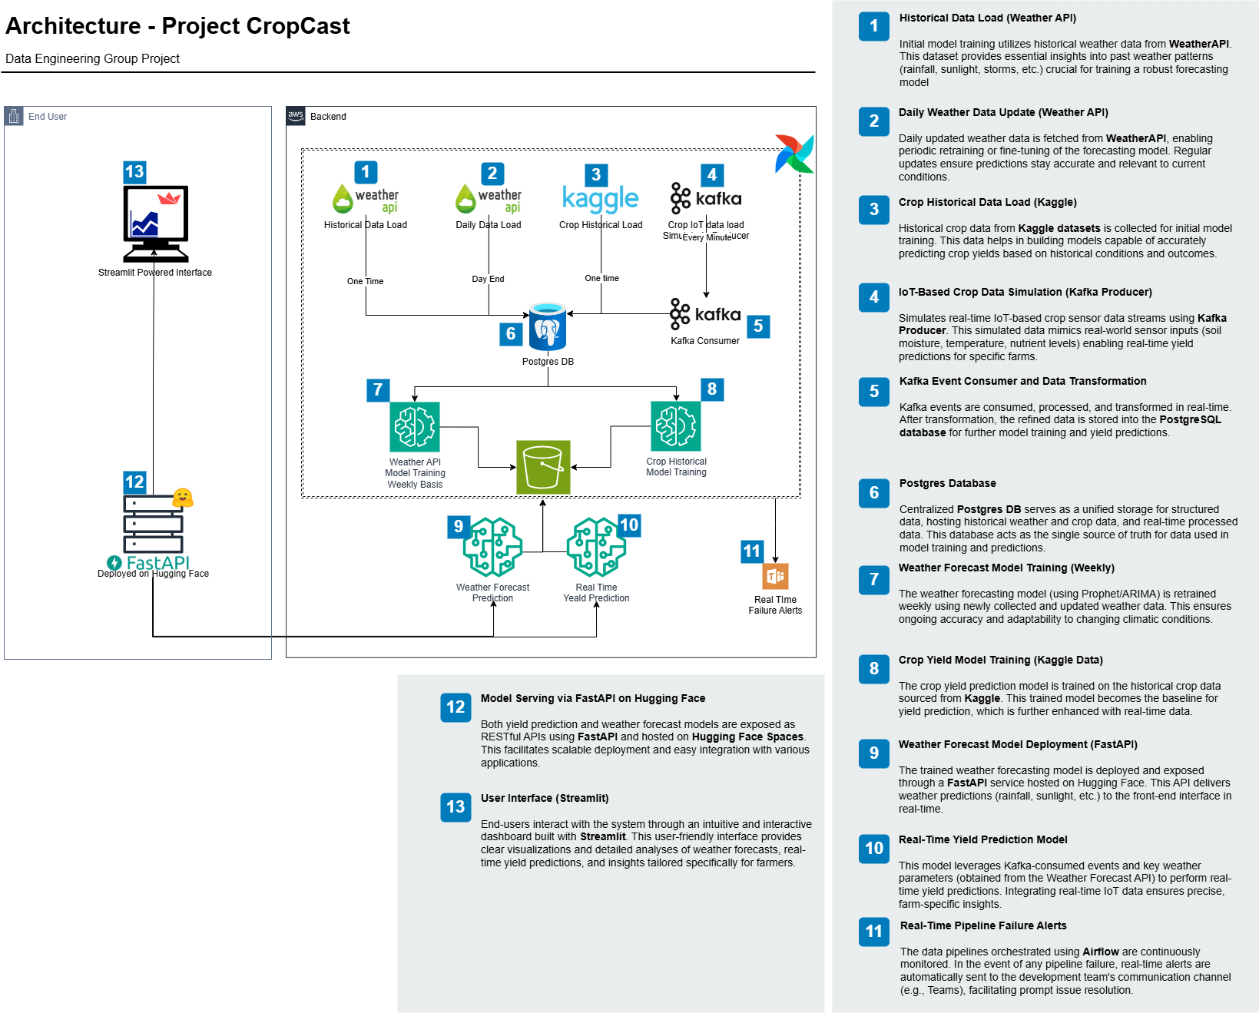
Old Architecture

